Slide 1
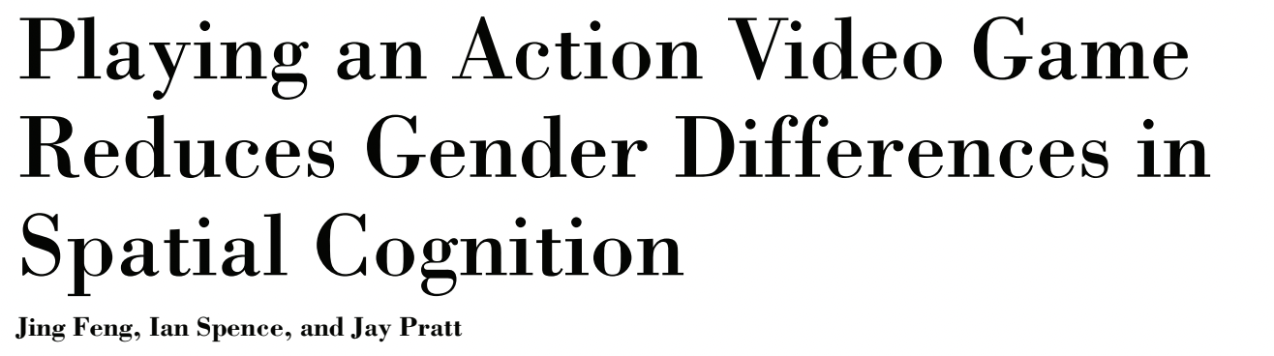
Psychological Science, 2007

Slide 2
Questions
Are there gender differences in spatial attention?
Can these gender differences decrease due to training?

Slide 3
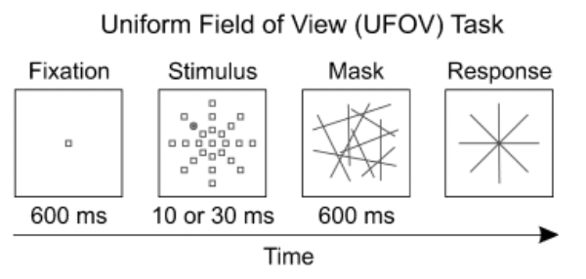
Experiment 1
Action video game players: > 4 hours per week
Non-players: no games in the past 3 years

Slide 4
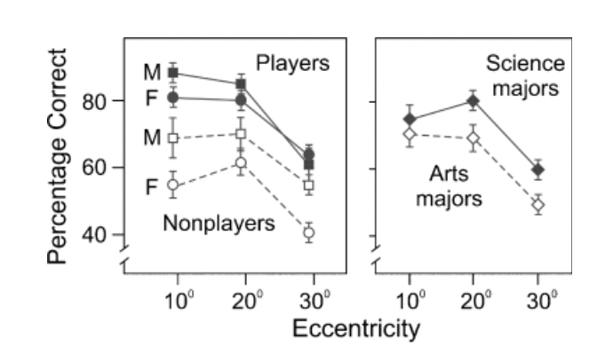

Slide 5
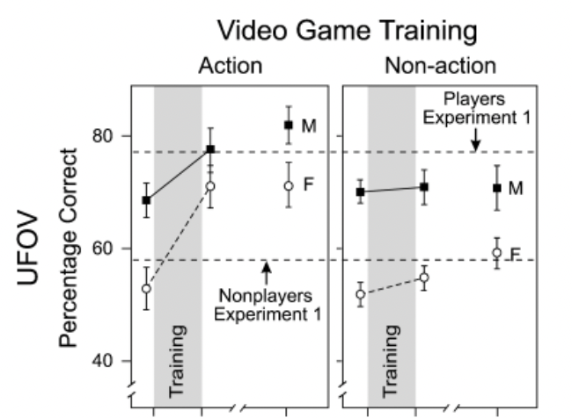
Experiment 2
Action video game training: 10 hours
Control group: 10 hours with a non-action game

Slide 6
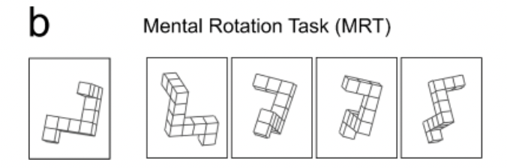
Also in Experiment 2
Action video game training: 10 hours
Control group: 10 hours with a non-action game

Slide 7

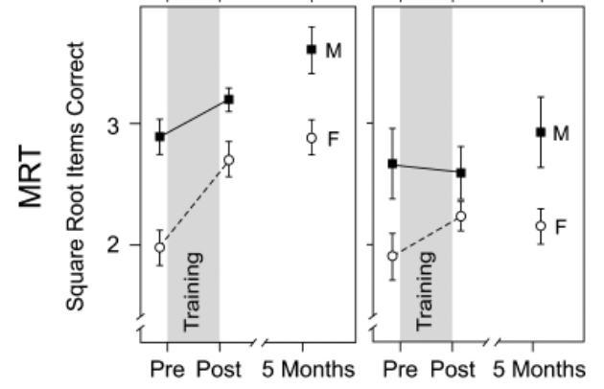

Slide 8
Conclusions
Gender differences in spatial cognition may be due to differences in practice rather than due to biological differences.
These differences can be overcome through modest training

